Slide 1
THE EFFECTS OF MICROPLASTICS ON HUMAN HEALTH IN INDIA
By Samruddhi Tawade
Research mentor: dr. vetria byrd

Slide 2
Project goals
Highlight any connections between health effects and microplastic pollution in a developing country
Not identifying concrete causations, only potential ones to focus on that for further research
Notes:
For this project I wanted to highlight any connections between health effects and microplastic pollution in a developing country, as they tend to get overshadowed in microplastic studies.
I am also not identifying any concrete causes, but rather looking for potential links for further research

Slide 3
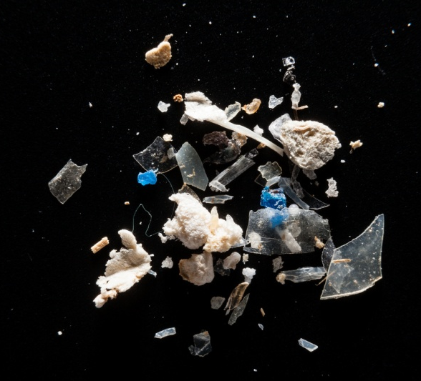


What is known about microplastics?
Plastics <5mm in length
Transported through water, food, and air
Few studies linking health issues to microplastics
More plastic pollution = more microplastics
This Photo by Unknown Author is licensed under CC BY
Notes:
They are less than 5 mm in length and can be transported through a variety of means
There are very few studies linking long term health issues to microplastics

Slide 4

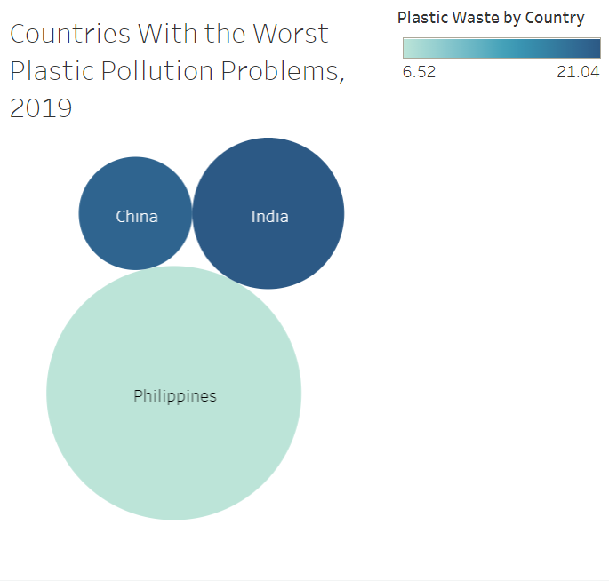
WHY INDIA?
Holds the largest share for mismanaged plastic waste
Philippines release more plastic into the ocean, but only account for 6% of world’s plastic pollution
India accounts for 12%
Focusing on health effects of extensive plastic pollution, so India seemed like the better choice
Figure 1.
Notes:
India holds the largest share for mismanaged plastic waste. Although Philippines releases more plastic into the ocean, india accounts for more pollution in terms of improper disposal and litter, so india seemed like the better choice for this study

Slide 5
Health effects of microplastics
Chose 3 effects to focus on based on redundancy in other research papers and relevance to this study
Tuberculosis
Breast Cancer
Lung Cancer
Will be looking at plastic pollution on the ground as well as air pollution, as both are strong sources of microplastic transmission
Notes:
I focused on these 3 effects because they were redundant in other microplastic studies and research, and I will be looking at air and ground pollution for the purpose of this project

Slide 6
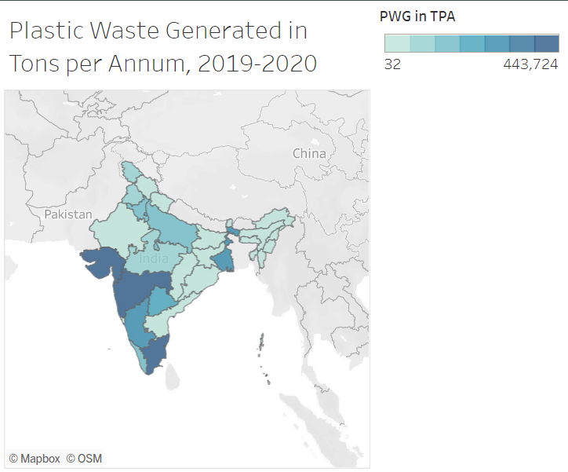
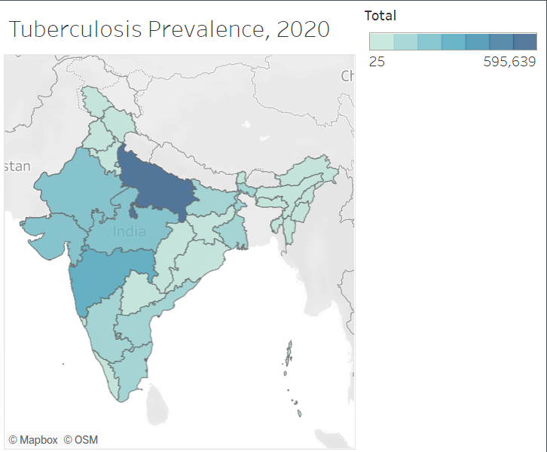
Ground pollution and tuberculosis
Maharashtra and Gujarat, and Tamil Nadu seem to generate the most plastic waste
Predict that tuberculosis rates will be high in this region
UP
G
G
M
M
T
T
Figure 2
Figure 3
Notes:
Starting with ground pollution and TB, Maharashtra, Gujarat, and tamil nadu generate the most plastic waste, so I predicted tb rates to be high in this region, however uttar Pradesh had the highest number of tb cases despite having a lower amount of mismanaged plastic waste. This could indicate that other factors have a larger effect on tb than ground pollution.

Slide 7
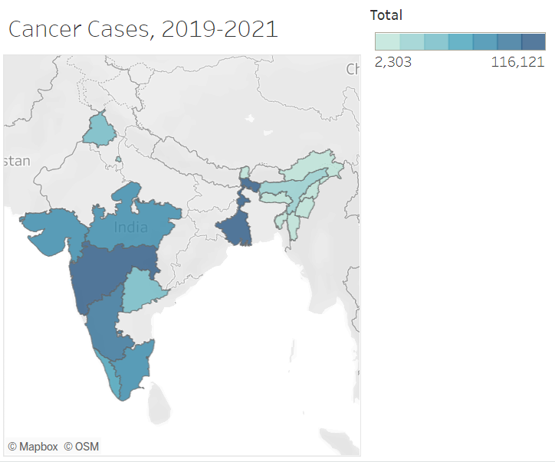
Ground pollution and CANCER
Maharashtra and Gujarat, and Tamil Nadu seem to generate the most plastic waste
Predict that cancer rates will be high in this region
UP
G
G
G
M
M
M
T
T
T
Figure 2
Figure 4
Notes:
Similar to the last slide, I predicted cancer rates would be high in this region, and the data actually seemed to line up. Maharashtra generated the most plastic waste and seemed to have the most cancer cases, while the northeastern states generated less waste and had fewer cases, suggesting a link between plastic waste and cancer rates

Slide 8
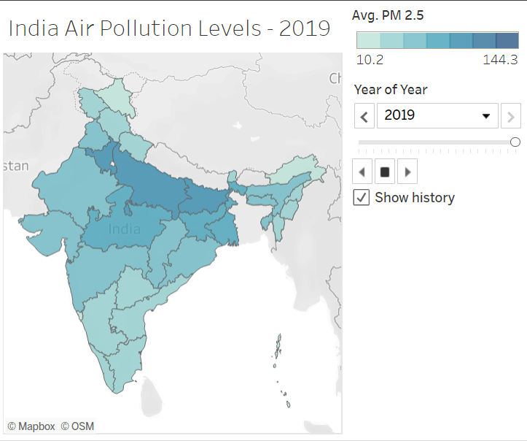
AIR pollution and Tuberculosis
Figure 5 and Figure 3 show strong correlations between air pollution and tuberculosis prevalence, because with such unhealthy air, it would not be uncommon for crowded populations to contract the disease. Worse air quality and higher populations could increase the risk of contracting the disease, while better air quality and smaller populations decrease the risk.
UP
G
G
M
M
T
T
T
Figure 5
Figure 3
Notes:
India’s air quality is so unhealthy that even the cleanest states are considered unhealthy by WHO guidelines. This is why I thought it was natural that states with unhealthier air would have more tb cases, while states with cleaner air would still have a significant amount of tb cases. The data here could potentially link tb to air pollution.

Slide 9
AIR pollution and Cancer
Do not show any correlations at first, but one could be established looking at the data for the northeastern states
UP
G
G
G
M
M
M
T
T
T
T
Figure 5
Figure 4
Notes:
As for cancer, at first it seems like there is no correlation, but a link could be established by observing that the northeastern states have fewer cancer cases and cleaner air quality, while the western and southern states have more polluted air and more cases. Due to large gaps in data however, this correlation may be a bit of a stretch

Slide 10

Findings and analysis + Next steps
TB and plastic pollution on the ground do not seem to have a strong correlation, but TB and air pollution do
Cancer rates might be influenced by both ground and air pollution
Cancer type for each individual case was not given, however, summarized reports of most prevalent cancer types were available on the national cancer registry
Lung cancer and breast cancer were among the top five listed in each state given, suggesting that plastic pollution has an impact on cancer rates
Study suggests that microplastics do have an impact on the prevalence of cancer and tuberculosis, to an extent.
Next steps would be to explore different countries, such as the Philippines, as they also have a severe plastic problem, to further solidify the proof that microplastics are linked to cancer and tuberculosis.
With this data, significant advancements could be made in targeting the problem at its source, while providing reliable help to the less fortunate in similar situations.
Notes:
In conclusion, TB and plastic pollution on the ground do not seem to have a strong correlation, but TB and air pollution do, while cancer rates may be influenced by both air and ground pollution. While data type for each individual cancer case was not provided, there was a summary of the top 5 most prevalent cancers in each state, and both lung and breast cancer were included. Because breast and lung cancer were consistently prevalent in each state, there may exist a connection between ground and air pollution, and breast and lung cancer.

Slide 11
Sources
Brauer, M. (2017). PM2.5 pollution, population exposed to levels exceeding WHO Interim Target-1 value (% of total) - India | Data. The World Bank.
https://data.worldbank.org/indicator/EN.ATM.PM25.MC.T1.ZS?end=2017&locations =IN&start=2010
Campanale, Massarelli, Savino, Locaputo, & Uricchio. (2020). A Detailed Review Study on Potential
Effects of Microplastics and Additives of Concern on Human Health. International Journal of Environmental Research and Public Health, 17(4), 1212. https://doi.org/10.3390/ijerph17041212
Central Pollution Control Board Delhi. (2021, September). Annual Report 2019–20 on Implementation of
Plastic Waste Management Rules, 2016. Central Pollution Control Board Ministry of Environment, Forest and Climate Change Government of India. https://cpcb.nic.in/uploads/plasticwaste/Annual_Report_2019-20_PWM.pdf
Giannadaki, D., Lelieveld, J., & Pozzer, A. (2016). Implementing the US air quality standard for PM2.5
worldwide can prevent millions of premature deaths per year. Environmental Health, 15(1). https://doi.org/10.1186/s12940-016-0170-8
​

Slide 12
Gurjar, B. R. (2021, April 5). Air Pollution in India: Major Issues and Challenges. TERI.
https://www.teriin.org/article/air-pollution-india-major-issues-and-challenges
Health effects of Microplastics & Pathogens. (2022, March 2). Plastic Health Coalition.
https://www.plastichealthcoalition.org/microplastics/
Hirsh, S. (2020, August 17). Microplastics Found in Human Organs, According to New Study. Green
Matters. https://www.greenmatters.com/p/microplastics-detected-human-organs
Hoffmann, B., Boogaard, H., de Nazelle, A., Andersen, Z. J., Abramson, M., Brauer, M., Brunekreef, B.,
Forastiere, F., Huang, W., Kan, H., Kaufman, J. D., Katsouyanni, K., Krzyzanowski, M., Kuenzli, N., Laden, F., Nieuwenhuijsen, M., Mustapha, A., Powell, P., Rice, M., . . . Thurston, G. (2021). WHO Air Quality Guidelines 2021– Aiming for Healthier Air for all: A Joint Statement by Medical, Public Health, Scientific Societies and Patient Representative Organisations. International Journal of Public Health, 66. https://doi.org/10.3389/ijph.2021.1604465
​ICMR - National Centre for Disease Informatics and Research. (2021a). Chapter 1: Cancer Profile of
North-East India. National Centre for Disease Informatics and Research India. https://ncdirindia.org/All_Reports/NorthEast2021/resources/NE_chapter1.pdf

Slide 13
ICMR - National Centre for Disease Informatics and Research. (2021b). Profile of Cancer and Related
Factors - Delhi 2021. National Centre for Disease Informatics and Research India. https://ncdirindia.org/All_Reports/State_Factsheet_21/Factsheet/FS_Delhi.pdf
ICMR - National Centre for Disease Informatics and Research. (2021c). Profile of Cancer and Related
Factors - Gujarat 2021. National Centre for Disease Informatics and Research India. https://ncdirindia.org/All_Reports/State_Factsheet_21/Factsheet/FS_Gujarat.pdf
ICMR - National Centre for Disease Informatics and Research. (2021d). Profile of Cancer and Related
Factors - Karnataka 2021. National Centre for Disease Informatics and Research India. https://ncdirindia.org/All_Reports/State_Factsheet_21/Factsheet/FS_Karnataka.pdf
ICMR - National Centre for Disease Informatics and Research. (2021e). Profile of Cancer and Related
Factors - Kerala 2021. National Centre for Disease Informatics and Research India. https://ncdirindia.org/All_Reports/State_Factsheet_21/Factsheet/FS_Kerala.pdf
ICMR - National Centre for Disease Informatics and Research. (2021f). Profile of Cancer and Related
Factors - Madhya Pradesh 2021. National Centre for Disease Informatics and Research India. https://ncdirindia.org/All_Reports/State_Factsheet_21/Factsheet/FS_Madhya_Pradesh.pdf

Slide 14
ICMR - National Centre for Disease Informatics and Research. (2021g). Profile of Cancer and Related
Factors - Maharashtra 2021. National Centre for Disease Informatics and Research India. https://ncdirindia.org/All_Reports/State_Factsheet_21/Factsheet/FS_Maharashtra.pdf
ICMR - National Centre for Disease Informatics and Research. (2021h). Profile of Cancer and Related
Factors - Punjab 2021. National Centre for Disease Informatics and Research India. https://ncdirindia.org/All_Reports/State_Factsheet_21/Factsheet/FS_Punjab.pdf
ICMR - National Centre for Disease Informatics and Research. (2021i). Profile of Cancer and Related
Factors - Tamilnadu 2021. National Centre for Disease Informatics and Research India. https://ncdirindia.org/All_Reports/State_Factsheet_21/Factsheet/FS_Tamilnadu.pdf
ICMR - National Centre for Disease Informatics and Research. (2021j). Profile of Cancer and Related
Factors - Telangana 2021. National Centre for Disease Informatics and Research India. https://ncdirindia.org/All_Reports/State_Factsheet_21/Factsheet/FS_Telangana.pdf
ICMR - National Centre for Disease Informatics and Research. (2021k). Profile of Cancer and Related
Factors - West Bengal 2021. National Centre for Disease Informatics and Research India. https://ncdirindia.org/All_Reports/State_Factsheet_21/Factsheet/FS_West_Bengal.pdf

Slide 15
ICMR - National Centre for Disease Informatics and Research. (2021l). Report of National Cancer Registry
Programme. National Centre for Disease Informatics and Research India. https://main.icmr.nic.in/sites/default/files/reports/NCRP_2020_2012_16.pdf
India. (2021, October 25). AQLI. https://aqli.epic.uchicago.edu/country-spotlight/india/
International Agency for Research on Cancer - World Health Organization. (2020). India Fact Sheet.
World Health Organization. https://gco.iarc.fr/today/data/factsheets/populations/356-india-fact-sheets.pdf
Kanungo, S., Sah, B., Lopez, A., Sung, J., Paisley, A., Sur, D., Clemens, J., & Balakrish Nair, G. (2010).
Cholera in India: an analysis of reports, 1997–2006. Bulletin of the World Health Organization, 88(3), 185–191. https://doi.org/10.2471/blt.09.073460
Mathur, P., Sathishkumar, K., Chaturvedi, M., Das, P., Sudarshan, K. L., Santhappan, S., Nallasamy, V.,
John, A., Narasimhan, S., & Roselind, F. S. (2020). Cancer Statistics, 2020: Report From National Cancer Registry Programme, India. JCO Global Oncology, 6, 1063–1075. https://doi.org/10.1200/go.20.00122
Mismanaged plastic waste. (2021). Our World in Data. https://ourworldindata.org/grapher/plastic-waste-
mismanaged?region=Asia&country=CMR%7EPHL%7EMYS%7ECHN%7EIND%7EBRA%7EGHA%7EARG%7ELKA
Population of Indian states 2019 - StatisticsTimes.com. (2020, May 13). Statistics Times.
https://statisticstimes.com/demographics/india/indian-states-population.php

Slide 16
Ritchie, H., & Roser, M. (2018, September 1). Plastic Pollution. Our World in Data.
https://ourworldindata.org/plastic-pollution#which-countries-produce-the-most-total-plastic-waste
Rustagi, N., Singh, R., & Pradhan, S. (2011). Public health impact of plastics: An overview. Indian Journal
of Occupational and Environmental Medicine, 15(3), 100. https://doi.org/10.4103/0019-5278.93198
Sherrell, Z. M. (2021, July 29). What to know about cancer survival, incidence, and death rates. Medical
News Today. https://www.medicalnewstoday.com/articles/cancer-rates-by-country#rates
Shrivastav, R. (2019, October 2). India’s plastic waste situation wasn’t created today. Down To Earth.
https://www.downtoearth.org.in/blog/waste/india-s-plastic-waste-situation-wasn-t-created-today-67061
TB statistics - India. (2022, April 20). TBFacts. https://tbfacts.org/tb-statistics-india/
Underdeveloped Countries 2022. (2022). World Population Review.
https://worldpopulationreview.com/country-rankings/underdeveloped-countries
Unique Identification Authority of India. (2020, December). State/UT wise Aadhaar Saturation (Overall) -
All Age Groups. https://uidai.gov.in/images/state-wise-aadhaar-saturation.pdf
van Uffelen, C. (2020, June 18). How damaging is breathing in microplastics? Plastic Soup Foundation.
https://www.plasticsoupfoundation.org/en/2018/03/how-damaging-is-breathing-in- microplastics/#:%7E:text=Particle%20pollution%20has%20long%20been,may%20cause%20similar%20health%20problems.

Slide 17
Wieland, S., Balmes, A., Bender, J., Kitzinger, J., Meyer, F., Ramsperger, A. F., Roeder, F., Tengelmann, C.,
Wimmer, B. H., Laforsch, C., & Kress, H. (2022). From properties to toxicity: Comparing microplastics to other airborne microparticles. Journal of Hazardous Materials, 428, 128151. https://doi.org/10.1016/j.jhazmat.2021.128151
Wikipedia contributors. (2022, April 20). List of states and union territories of India by population.
Wikipedia. https://en.wikipedia.org/wiki/List_of_states_and_union_territories_of_India_by_population
Wright, S. L., & Kelly, F. J. (2017). Plastic and Human Health: A Micro Issue? Environmental Science &
Technology, 51(12), 6634–6647. https://doi.org/10.1021/acs.est.7b00423
Yan, F., Zhu, F., Wang, Q., & Xiong, Y. (2016). Preliminary Study of PM2.5 Formation During Municipal
Solid Waste Incineration. Procedia Environmental Sciences, 31, 475–481. https://doi.org/10.1016/j.proenv.2016.02.054

Slide 18
Thank you for listening!

